Slide 1
Unified mentor internship project presentation
BY
ANIMESH DUTTA
POSITION : DATA ANALYST INTERN
INTERNSHIP ID : UMID01052533819
2 MONTHS INTERNSHIP
INTERNSHIP DURATION : 15/05/2025 -15/07/2025

Slide 2
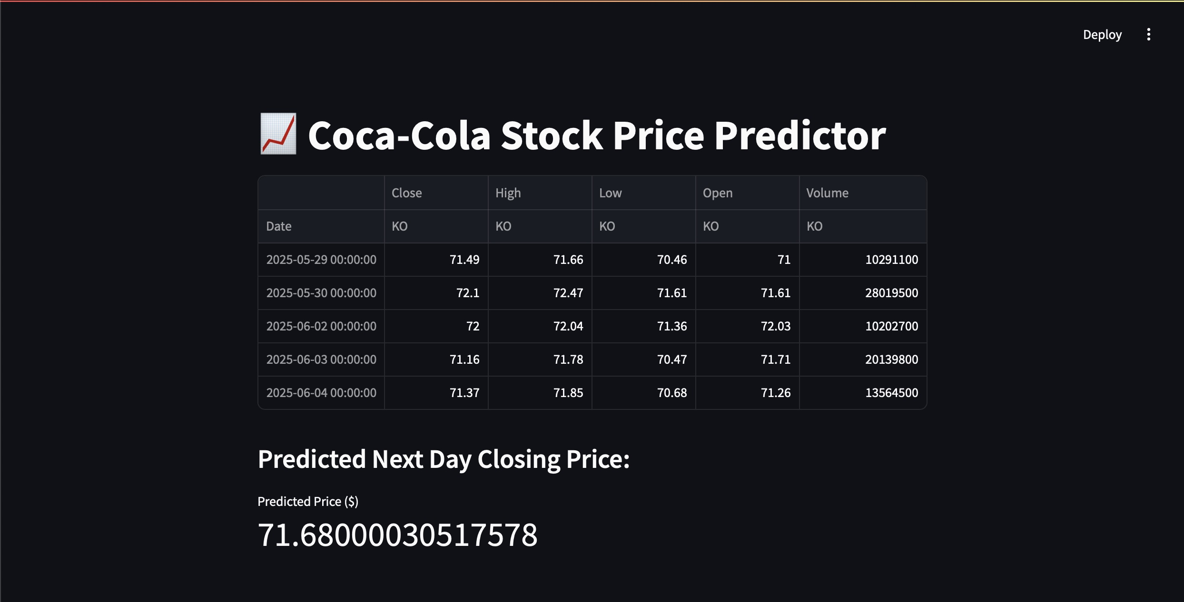
Coca Cola Stock - Live and Updated

Slide 3
contents
Introduction
Project objectives
Tools and technology Used
Methodology ( steps performed and outputs )
Data visualization and insights
conclusion

Slide 4
INTRODUCTION
This project focuses on predicting the future stock prices of coca-cola (KO) using historical stock data. It utilizes machine learning techniques, specifically A long short-term memory (LSTM) neural network model, to forecast daily closing prices.
This project demonstrates a data-driven approach to anticipate stock market movements.

Slide 5
Project Objectives
perform comprehensive data loading and data preprocessing
To gain insights into potential stock movements to support informed investment decisions.
To showcase the practical application of deep learning techniques (lstm) in financial time series forecasting.
To develop a robust predictive model capable of forecasting the next day's closing price of Coca-Cola (KO) stock.

Slide 6
Tools and technology used
Programming Language: Python
Platform used: visual studio code and jupyter notebook
Technologies: machine learning => Deep learning
Key Libraries/Frameworks:
Y finance: For efficient retrieval of historical stock data.
pandas & numpy: Essential for data manipulation, analysis, and numerical operations.
matplotlib.pyplot & seaborn: Utilized for data visualization, including historical price trends and data distributions.

Slide 7
Tools and technology used
Key Libraries/Frameworks:
sklearn.preprocessing.MinMaxScaler: For data normalization, a critical step for neural network performance.
TensorFlow / Keras: The core framework for building, training, and evaluating the deep learning LSTM model.
Streamlit: For creating an interactive web application for real-time predictions.

Slide 8
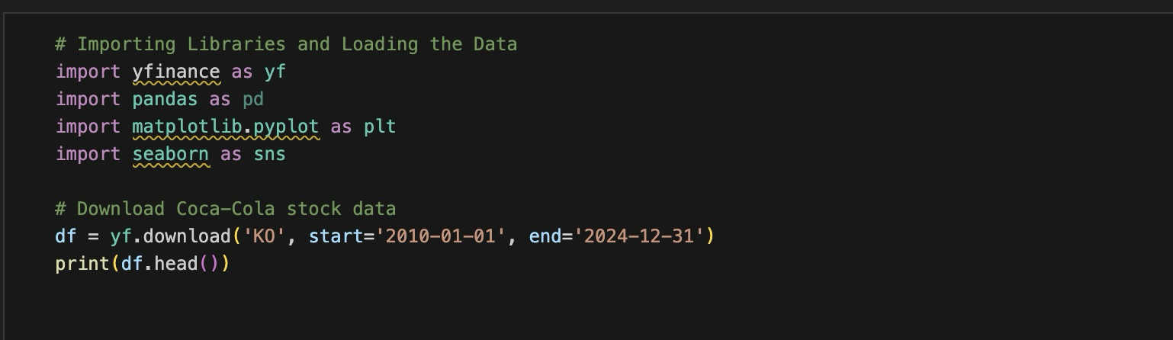
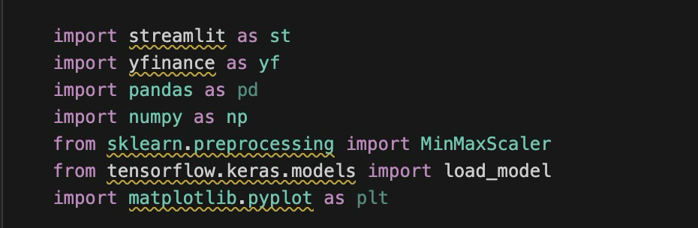
Snapshots of framework used in this project

Slide 9
methodology
Data Collection: Historical daily stock data for Coca-Cola (KO) was obtained from Yahoo Finance, covering a period from 2010 onwards.
Data Preprocessing:
The 'Close' price column was isolated as the target variable.
Data was scaled using MinMaxScaler to bring values into a 0-1 range, optimizing it for the neural network.
The dataset was then transformed into sequential inputs, where each prediction is based on the preceding 60 days of closing prices.

Slide 10
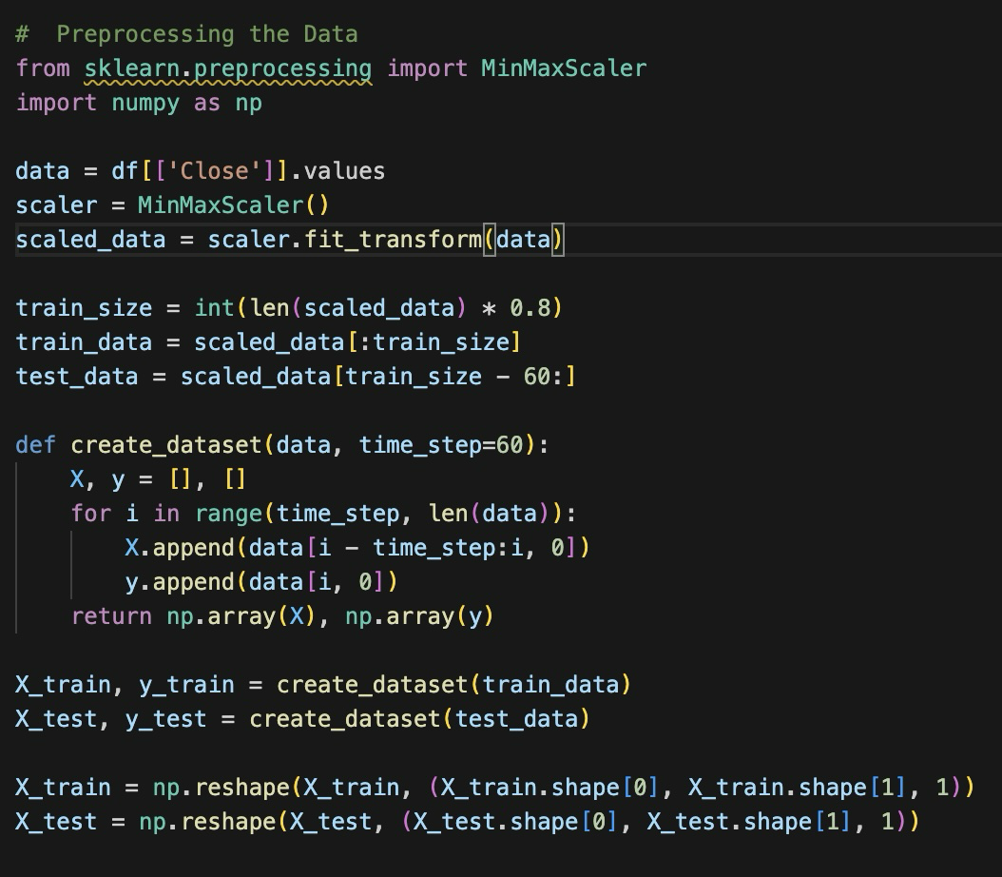
Code snapshot data preprocessing

Slide 11
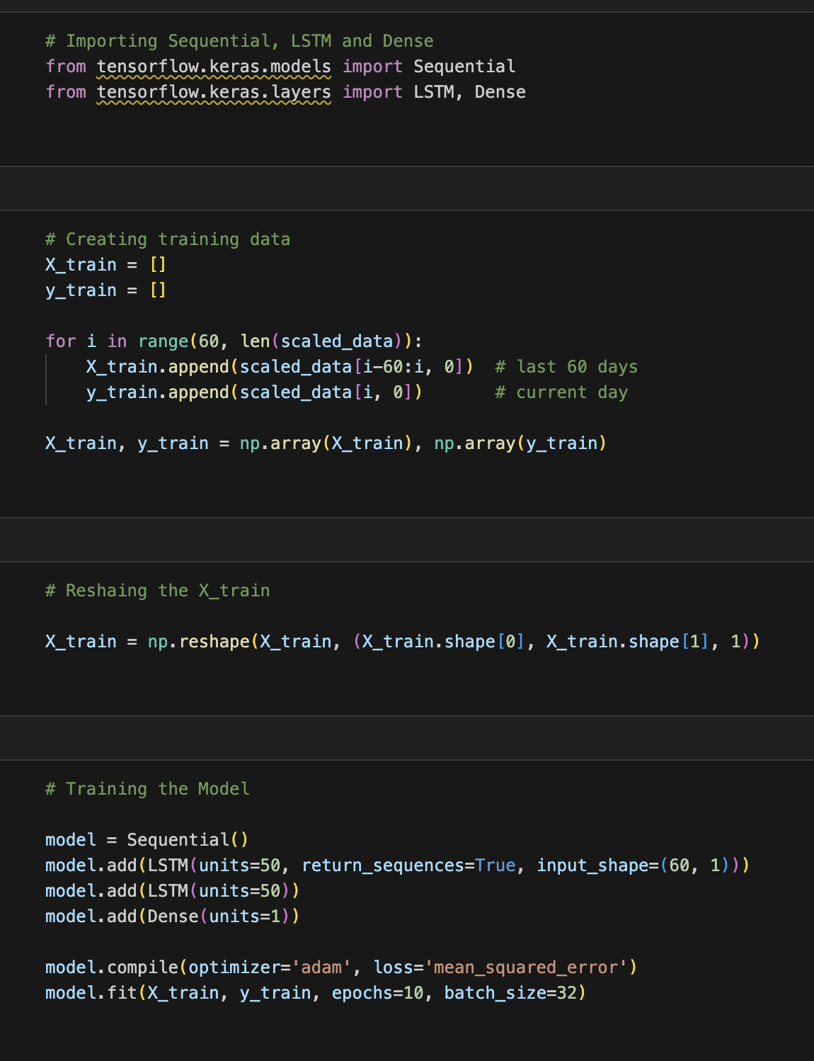
3. Model Architecture (LSTM Neural Network):
A Sequential Keras model was constructed, featuring multiple LSTM layers.
Dropout layers were incorporated to mitigate overfitting and enhance model generalization.
Dense layers were used for the final output prediction.
Code snapshot lstm model architecture

Slide 12
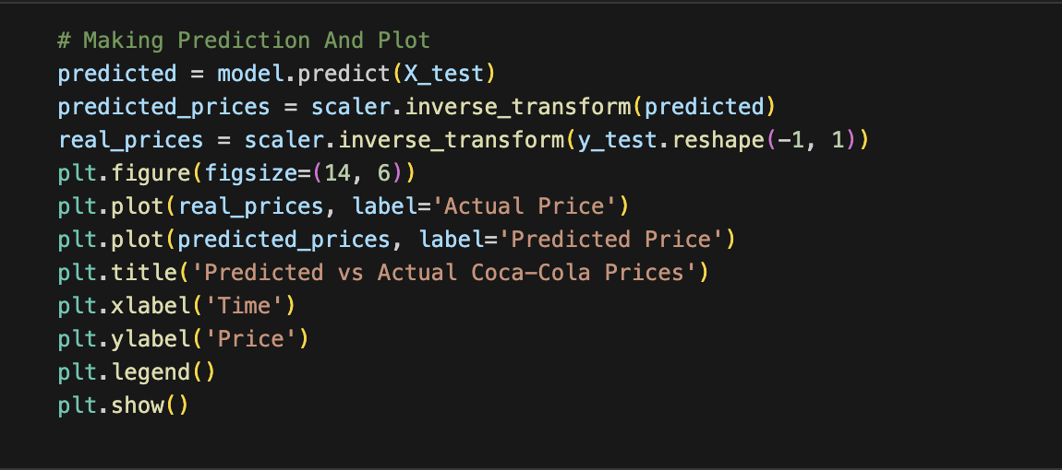
4. Model Training: The LSTM model was compiled with the ‘adam' optimizer and 'mean square error' as the loss function, then trained using the prepared historical data.
Prediction: The trained model predicts the next day's closing price by feeding it the latest 60-day sequence of historical data. The predicted value is then inverse-transformed to its original price scale.
SNAPSHOT CODE OF MODEL PREDICTION

Slide 13
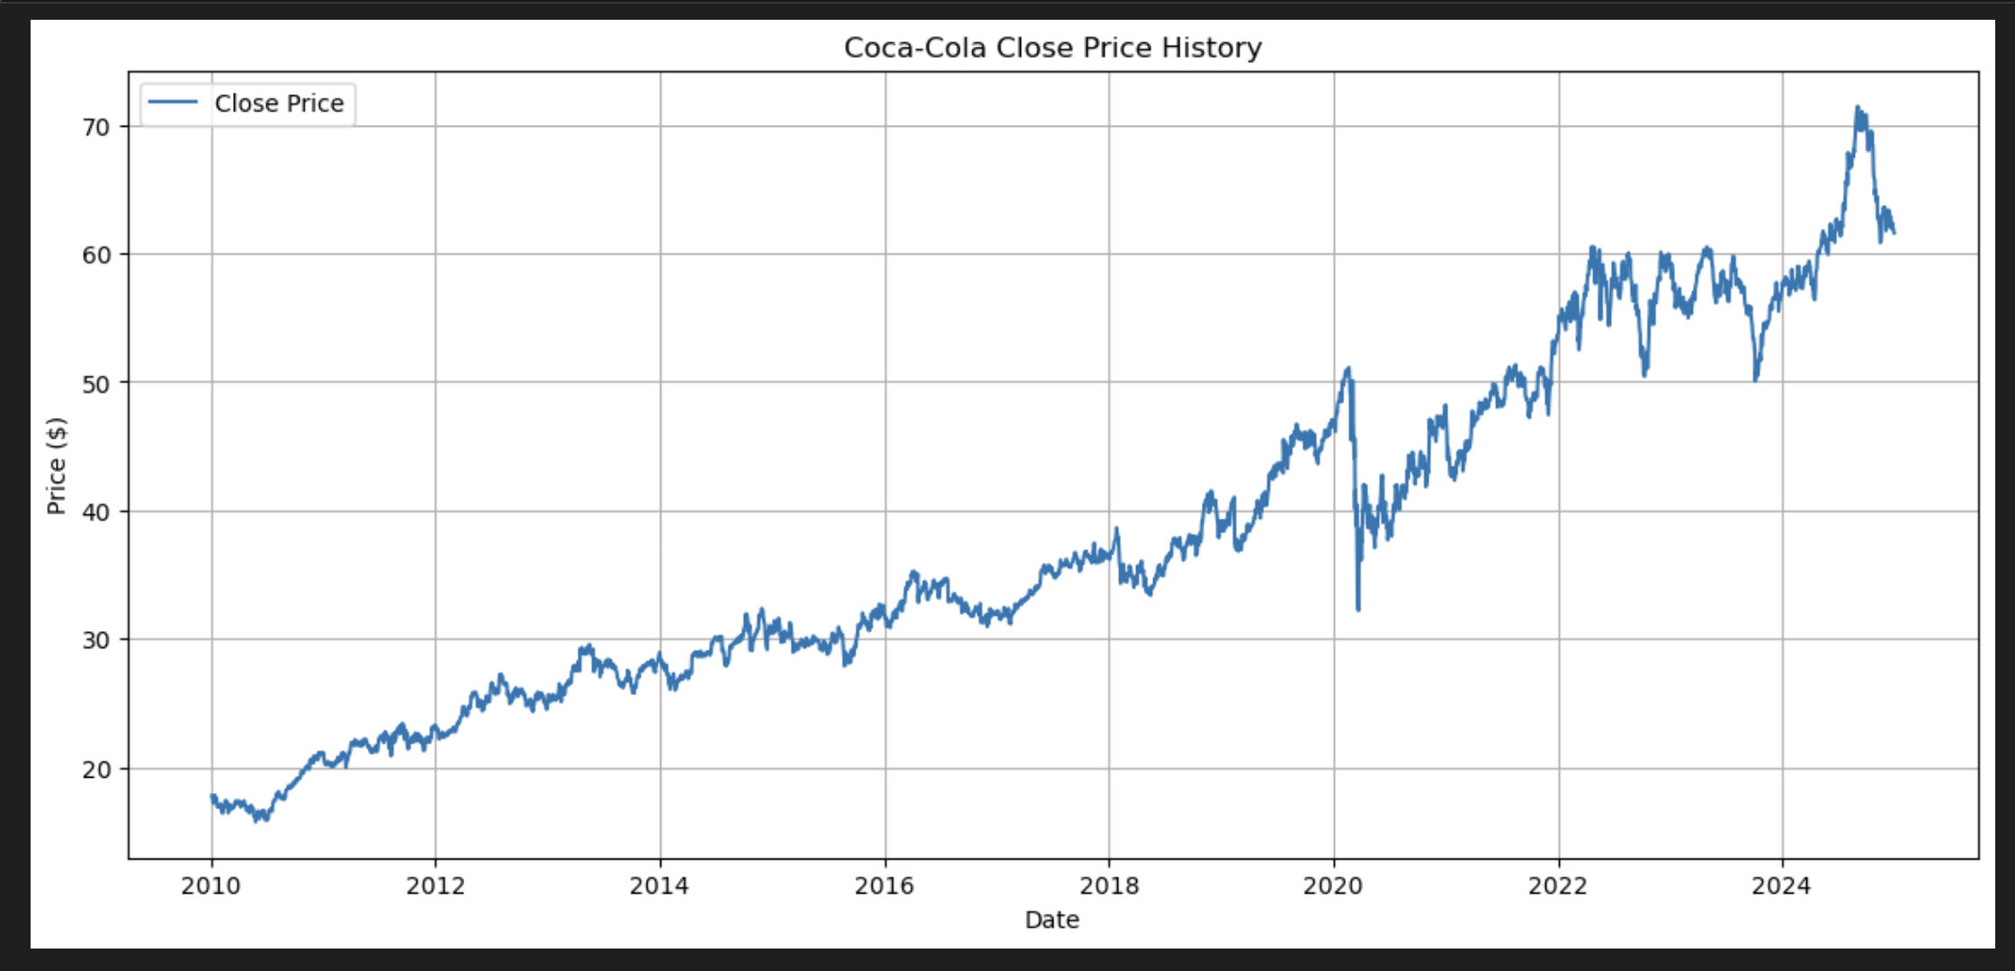
DATA VISUALIZATION AND INSIGHTS
Historical Closing Price Trend
This visualization provides a clear overview of the stock's performance over time, highlighting overall trends, periods of volatility, and significant price movements. It helps in understanding the historical context of the data used for prediction.

Slide 14
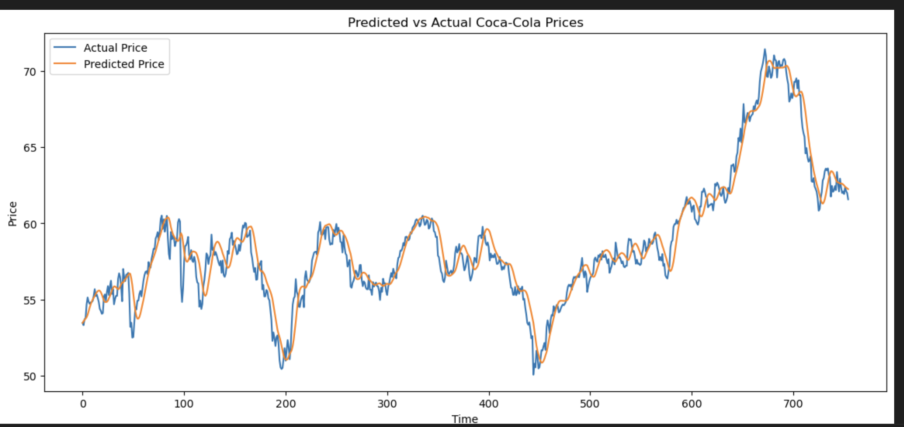
DATA VISUALIZATION AND INSIGHTS
Actual vs. Predicted Prices :
This graph visually compares the actual closing prices of Coca-Cola stock (blue line) against the predicted closing prices generated by the model (orange line) over a specific time period. The close alignment of the orange line with the blue line indicates that the model is performing well in forecasting the stock's movements.

Slide 15
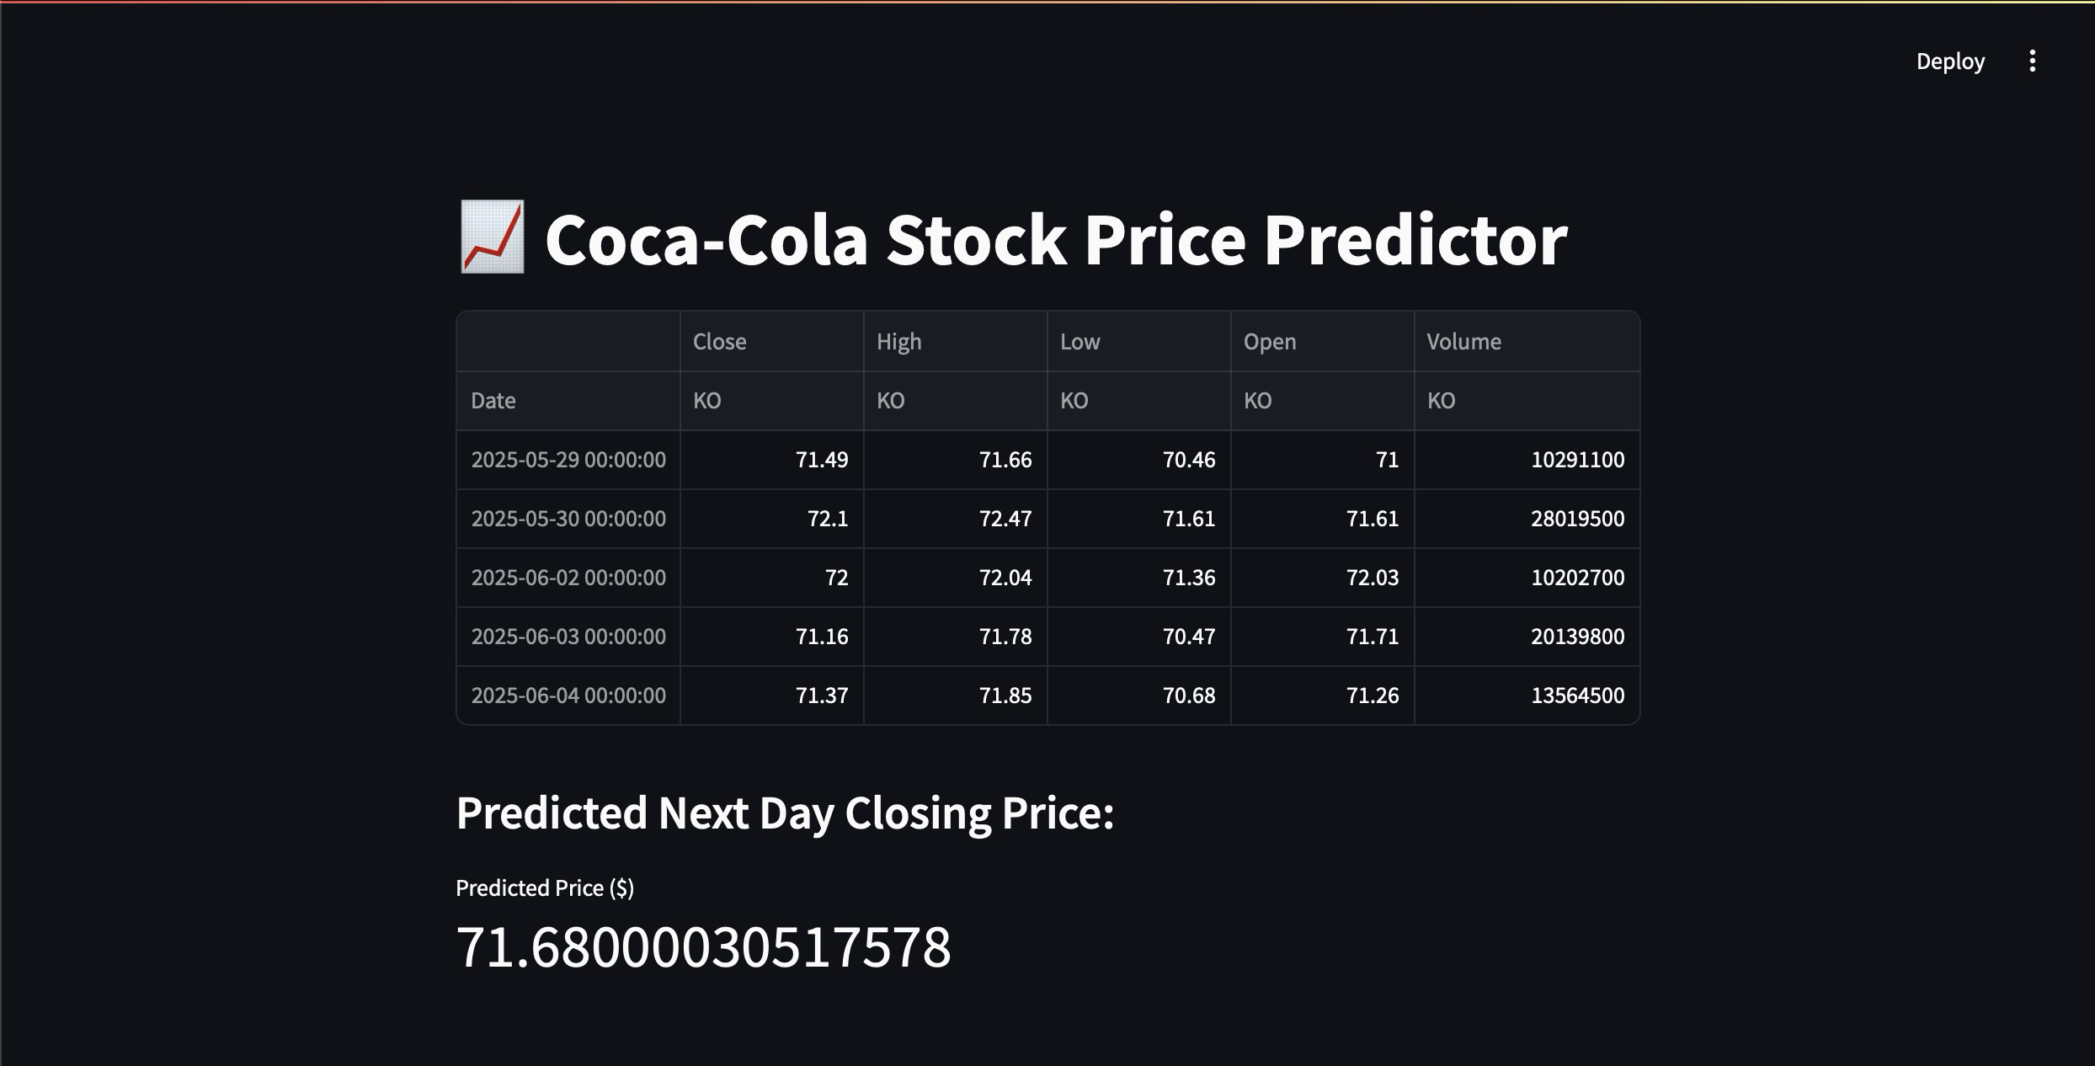
DATA VISUALIZATION AND INSIGHTS
Coca-Cola stock price predictor
a Streamlit web application for predicting Coca-Cola stock prices. It shows the historical stock data, a specific predicted next-day closing price ($63.38 in this example), and confirms that the prediction is generated by a loaded machine learning model. This indicates a live, interactive system providing real-time stock forecasts.

Slide 16
Conclusion
Key Findings and Project Outcome
The project successfully developed an LSTM model capable of forecasting the next day's closing price for Coca-Cola stock.
The model provides a data-driven prediction that can serve as a valuable indicator for potential investment strategies.
The live updating system offers immediate insights.
PROJECT 1 CONCLUDES

Slide 17
The thankyou note
I am truly grateful towards unified mentor for giving me this wonderful opportunity to work as a data analyst intern for this past 2 months, I have learned about many concepts that will be essential for my data analyst journey in coming future. The detailed and full projects of mine will be provided in the git hub link below.
Project : Coca Cola stock price analysis

Slide 18
thankyou

